Slide 1
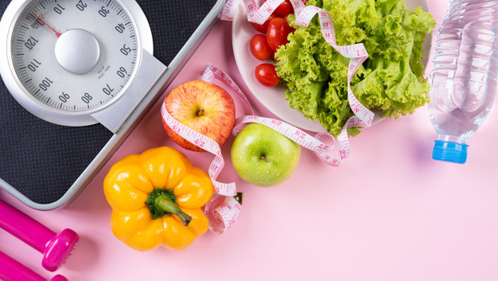
FAO THE APP THAT MAKES YOU EAT HEALTHY
Felici Rocco Silva Edoardo Vitali Tommaso

Slide 2

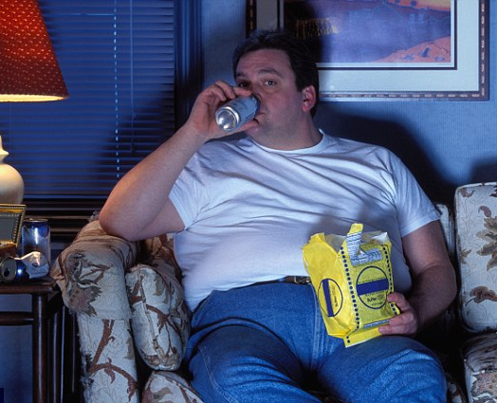
MOTIVATION
Too lazy to search for a tasty and – at the same time – healthy recipe, using the ingredients you have at home? Healthy for who?
This app will try to help people having a correct diet and eat the proper foods that supply their needs based on the calories burnt during the day, accounting what food they have at their disposal.

Slide 3
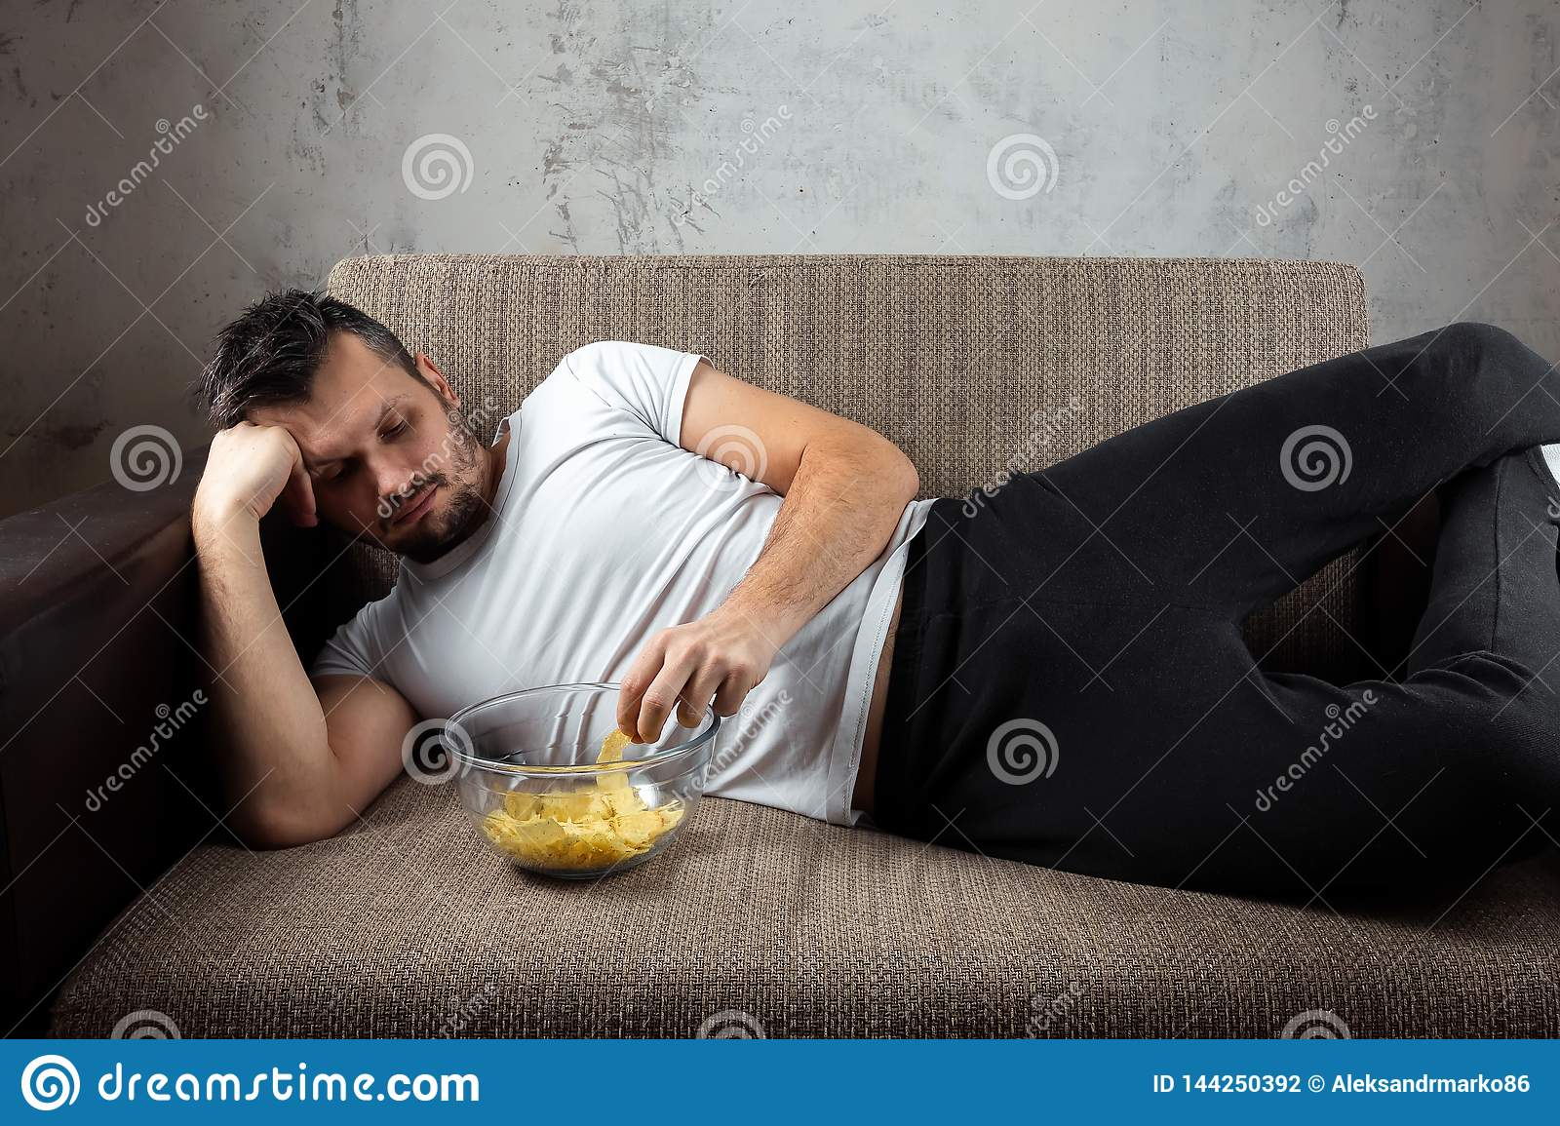

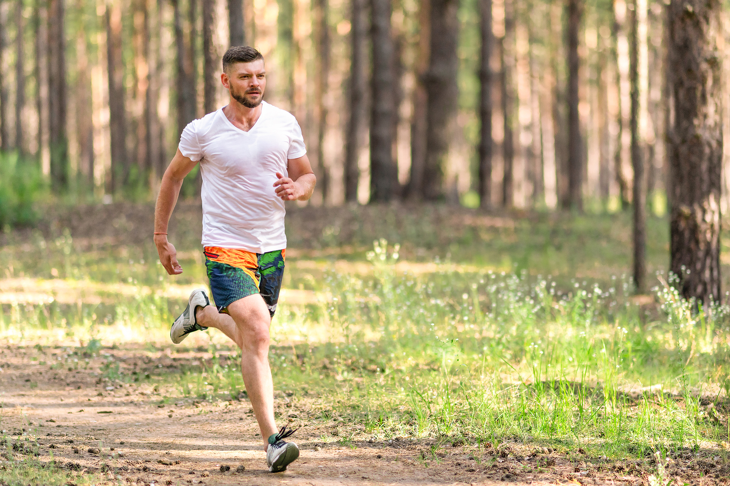
IMPLEMENTATION
The app will try to motivate even the laziest users sending regularly notifications.
It is going to be implemented based of the step-app used in the course tutorials.
Recipes and ingredients will have their own external databases, so the app requires an internet access to fully work.
The steps done will be held in local memory, and then converted in calories using also weight and height informations.
The main algorithm will access databases and calories got from the last meal and search the possible recipe based on that and the available ingredients.
Notifications and data visualization – along with user’s informations – will be customizable in the dedicated setting page.

Slide 4
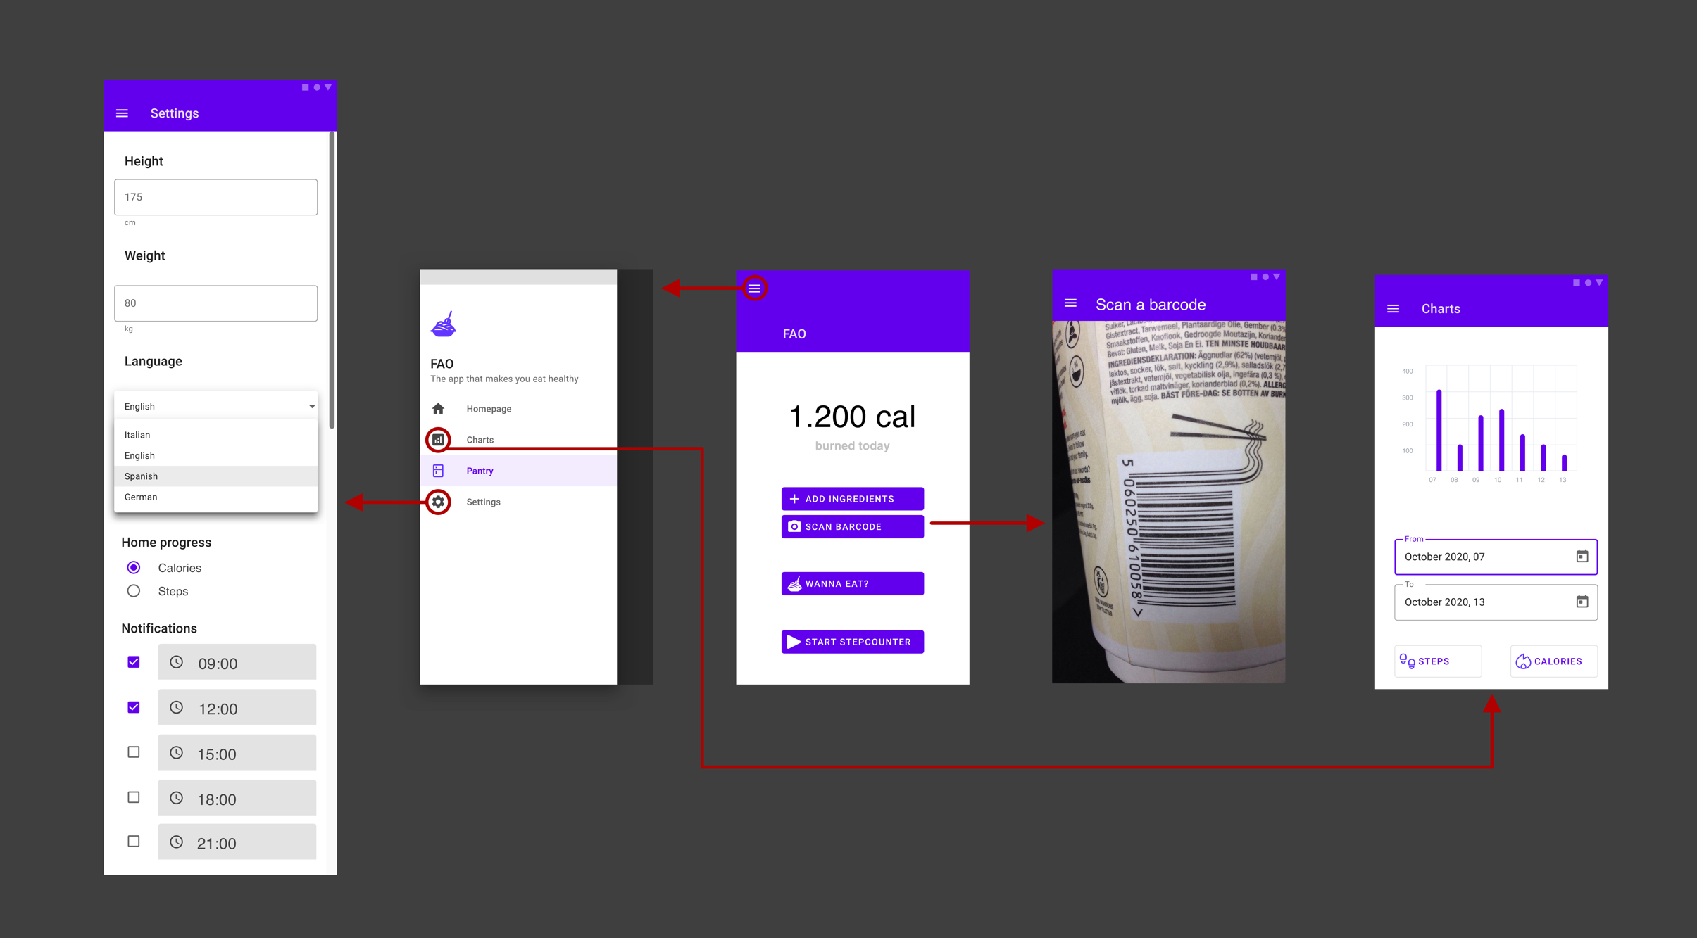
STORYBOARD

Slide 5
Thanks for your attention! Any questions?

